Slide 2
MINISTRY PORTFOLIO

Slide 3
Vision
ECOFI is a carrier on Missionary work for the spread of Christian Faith to every Tribe and Nation by the “Gospel of Christ” in an effective way of Evangelism and Propagation of churches and schools for a fruitful and quality result.
Mission
~Is to provide effective and strategic way of soul winning with quality service,
innovation and leadership for today and in the future
~To establish a sense of urgency and to create, seek and grab opportunities and encourage everyone to work on the system in a full strategic alignment.
~To promote and provide training and education through Seminars and Institution

Slide 4
We believe that both Old and New Testaments constitute the Divinely Inspired Word of God in the original languages and manuscripts. We believe in one God existing eternally in three Persons: Father, Son and Holy Spirit. We believe that the Lord Jesus Christ, the Son of God, became man without ceasing to be God, in order that He might reveal God and redeem sinful man. We believe that the Holy Spirit came forth from the Father and the Son to convict the world of sin, of righteousness, and of judgment; and to regenerate, sanctify, comfort and seal those who believe in Jesus Christ. We believe that man is totally deprived in that of himself he is utterly unable to remedy his lost condition. We believe that salvation is the gift of God brought to man by grace and received by personal faith in the Lord Jesus Christ, whose atoning blood was shed on the cross for the forgiveness of sins.
Goal
- That every barangay, rural and cities must have at least 1 local church planted and established as the result of effective evangelism in every year.
TENETS of Faith

Slide 5
Every member of the Evangelical Christian Outreach Foundation, Inc. Is required to subscribe to and live according to the following code of ethics:
1. The minister must keep the nobility of their calling uppermost in his own mind.
2. The minister must hold high in outward acts the established reputation of the Christian Ministry.
3. The minister must not use their ministerial position to get financial gain.
4. The minister must at all times be careful not to indulge in gossip while serving The Flock.
5. The ideal minister will hold his people equal in his heart. The minister will be very discreet in his conduct toward women.
6. The confidential statements made to a minister by his members are privileged and should never be divulged without the consent of those making them.
7. It is unethical for a minister to take sides with factions in his local church.
8. As fellow labourers in the Vineyard of the Lord and brothers and sisters in the service of the same Saviour, the relation between ministers should be one of frankness and cooperation.
“Behold how good and how pleasant it is for brethren to dwell together in unity.” Psalm 133:1
CODE OF ETHICS

Slide 6
It was 1954, the war was over, and the world was getting back on its feet. This was the year, our founder; director was invited to come to Zamboanga City, Philippines.
Little realizing this would change the scope of his ministry and develop a fruitful ministry.
This new ministry would change the lives of thousands. Today, the singing evangelist has become as one with the Filipino.
Immediately after surveying the field, he gained their confidence and began bringing the gospel to those with darkened minds, and returned to America with a heavy heart.
Brief ECOFII History
But with the burden and concern upon his mind, God gave him a plan. He enlisted Christian farmers, ranchers to feed “Cattle for Christ.”
This 1st chapter was organized in Nebraska. Today, there are such fellowships in Kansas, South Dakota; DNA Laymen who are not farmers are regular supporters of the foreign ministry.

Slide 7
In 1956, returning to the Philippines, over mountain ranges by horseback, the 1st worker joined Dr. Williams was Rev. George Young. Although this 1st Church was established among the Blaan people, they came from many areas, and tribes. Today, this 1st Church is thriving, with outstanding attendance.
The four footed Carabao brought him to the tribal people living in the mountains. Finally an old military truck left behind by American military was made possible by Rev. George Young.
But even that could not cross the rivers, and rocks. So a make shift raft was supplied, as he crossed the swollen streams.
Rev George Young brought Dr. Keith Williams to Davao City and Introduced to Rev. Gavino Fernandez who was presently the Pastor and Founder of an Independent group which was Christian Evangelical Mission Inc.
Dr. Williams has celebrated his birthday in the Philippines, most every year, since 1956. With the need of workers a once a month class was used, to train workers for the expanded ministry. But even that did not suffice, so today.
With the Bible Colleges, providing Pastors from the alumni, today, the Churches are expanding, and building up the Kingdom of God.
The ministry under the Direction of its founder/Director continues to expand, building lives for Christ.

Slide 8
ECOFI Flow Chart

Slide 9
EVANGELICAL CHRISTIAN OUTREACH FOUNDATION INC. ( ECOFI)
TWO COMPONENTS OF MINISTRY
FIELD
The Field is comprises of 13 Districts all over Mindanao.
70% belongs to different tribes in Mindanao
SCHOOLS
2 Bible schools
Keith Williams Bible School Kilometer 9, Catalunan Pequenio, Davao City
Keith Williams Bible School in Big Margus, Glan , Sarangani Province

Slide 10
Mindanao Map

Slide 11
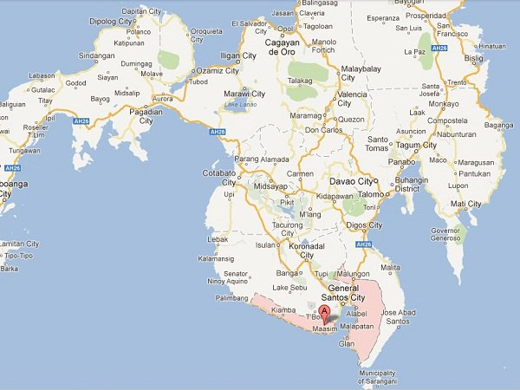
We have Churches.

Slide 12
Ministry Engagements
* Pastors Conferences
* Couples Seminars
* Youth Seminars
* Outreaches (Children Street Teaching. Street Preaching)
* Evangelistic Nights
* Concerts and Religious Nights
* Bibles studies, Evangelism, Discipleship

Slide 13
The ECOFI field ministry is doing good. 1. The Church are intact. 2. The Pastors are doing good job. 3. 2020-2021 at least 7 New Church are open. 4. 1,520 new baptized believers. 5. The Local convention are going on this month in preparation for the National Clusters Pastors Conferences.

Slide 14
Prayer Concern: Materials Needed for church buildings to the newly open churches that will be built in 15 Barangay at Tiboli Monicipality for this year 2022,

Slide 15
Comparative Statistical Data for 2019-2021

Slide 16
Pastors & Workers: 2019-2021

Slide 17
Churches: 2019-2021

Slide 18
Keith Williams Bible SCHOOL
Davao and Sarangani Campus Enrollees:
Davao Campus | School Year 2018 – 2019 | School Year 2019 - 2020 | School Year 2020 - 2021
1st Semester | 40 students | 31 students | 22 students
2nd Semester | 40 students | 27 students | 22 students
Sarangani Campus | School Year 2018 - 2019 | School Year 2019 - 2020 | School Year 2020 – 2021
1st Semester | _____ students | 33 students | 31 students
2nd Semester | _____ students | 32 students | 26 students

Slide 19
Davao & Sarangani Campus Graduates:
KWBC Davao | School Year 2018-2019 | School Year 2019-2020 | School Year 2020-2021
Graduates | 9 Graduates | 14 Graduates | 12 Graduates
Sarangani Campus | School Year 2018-2019 | School Year 2019-2020 | School Year 2020-2021
Graduates | Graduates | 42 Graduates | 5 Graduates
Note: We have 69 graduates from SY 2019-2021.

Slide 20
2022 Ministry Goals
To establish 5 Churches.
To build up the new Administration Building.
For every District to send at least 2 students every school year to KWBS.

Slide 21
2022 Calendar of Activities
January
February
March
KWBC Foundation
Graduation
2019-2020
2020-2021
2021-2022
Clusters Pastors and Workers Conference
April
May
June
National Prayer and Fasting
1st Sunday of June
KWBC Classes Start 1st Semester
July
August
Pastors Month
September
Thanksgiving Celebration
Local Seminars
October
November
KWBC Classes Starts for 2nd Semester
December
District Youth Activities
Couples Seminars

Slide 22
“Behold how good and how pleasant it is for brethren to dwell together in unity.” Psalm 133:1

